Slide 1

DataGlacier Week 13 Deliverables
Group Name: MacroStaff

Slide 2
Project: Cross Selling Recommendations Group Specialization: Data Analyst
Group Members:
Wasiq Ahmed
Email: wasiqahmed7@gmail.com
Country: Turkey
University: Bilkent University
Github Repository: https://github.com/Wasiq147/DataGlacier-proejct.git

Slide 3
Problem Description
A company called XYZ Credit Union currently has data about its customers and their purchased banking products. Since this data is highly clustered and not properly formatted, the company needs assistance in cleaning the data of potential invalid or repeated entries.

Slide 4
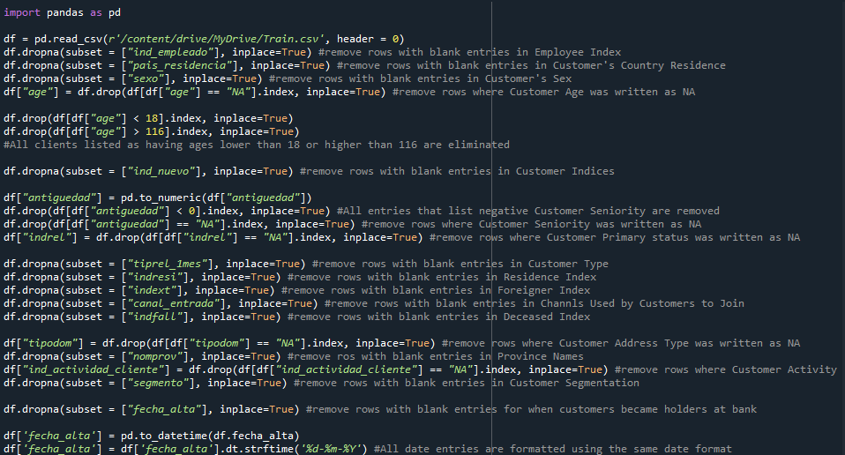
Data Cleaning with Python on ‘Train.csv’

Slide 5
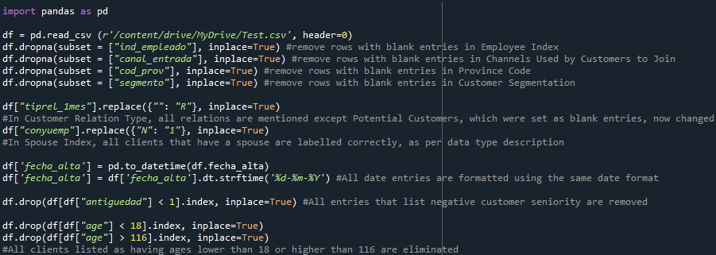
Data Cleaning with Python on ‘Test.csv’

Slide 6
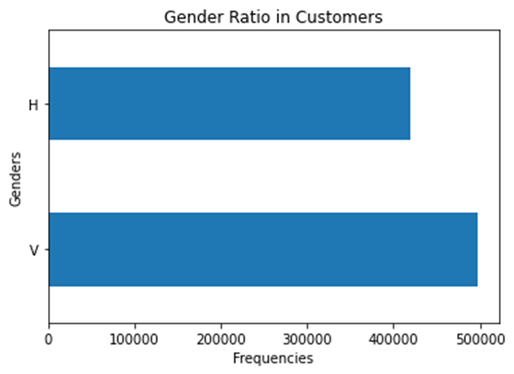
Gender Ratio in Customers
A ratio of 1.19:1 is seen for H:V
Roughly a difference of 77,769 records observed
No bases for biases

Slide 7
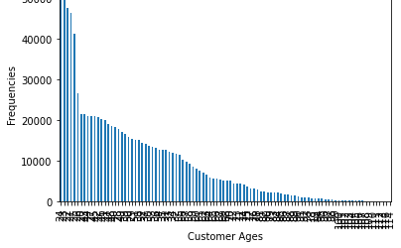
Customer Age Group
Primary age group ranges from 18 to 27
This age group covers nearly 50% of all customers
As age groups increase beyond 27, number of customers decreases with advanced ages

Slide 8
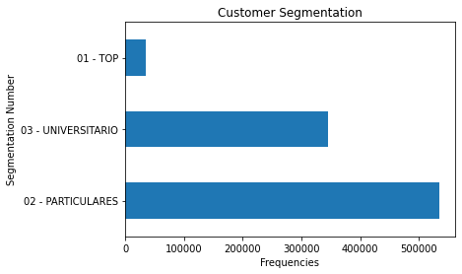
Customer Segmentation
Customers divided into 3 segments, with students and elite segments
Segmentation shows potential for targeted marketing
Largest segment of standard customers
Standard customers usually not entitled to unique benefits

